Slide 1
Frequency Filtering

Slide 2
Objectives
To induce periodic noise to an image
To implement Fourier Transform function with less time complexity
To apply frequency filters on the noise induced image
To suggest the user with best filter for the given image

Slide 3
Subtopics
Noise - Periodic noise
Fourier Transform - Exploring the symmetry, Divide and Conquer
Frequency filters - Ideal, Butterworth, Gaussian, Olympic, Homomorphic

Slide 4
Noise Induction
Periodic Noise
It is a type of spatially dependent noise
It arises typically from electrical or electromechanical interference during image acquisition
It can be reduced significantly via frequency domain filtering

Slide 5
Fourier Transform
By capturing the symmetry in the values in the output matrix, the complexity in calculating the FFT can be reduced significantly.

Slide 6
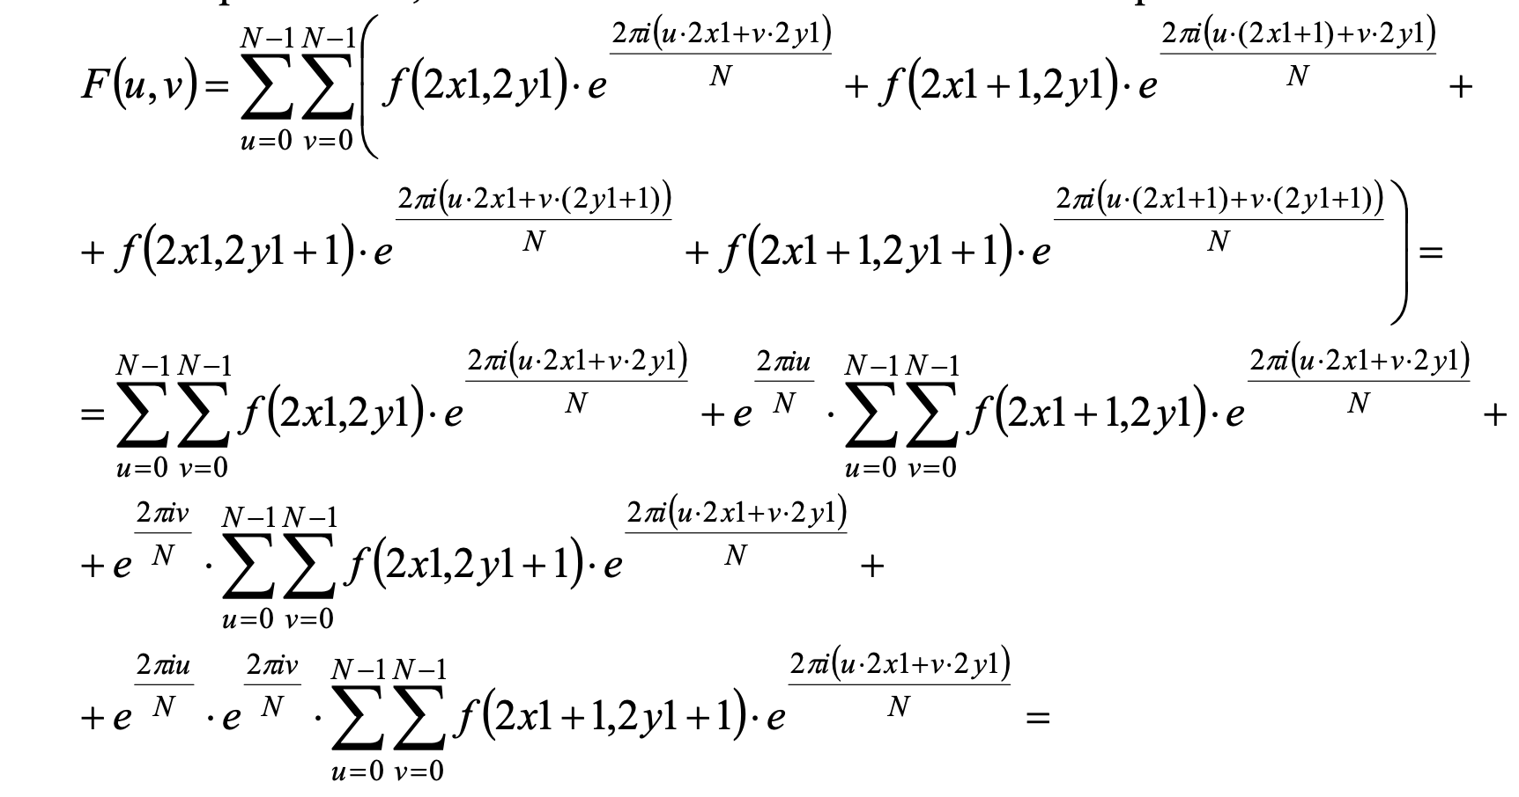
Divide and Conquer

Slide 7
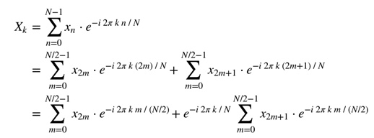
Exploring Symmetry

Slide 8
Fourier Transform
By capturing the symmetry in the values in the output matrix, the complexity in calculating the FFT can be reduced significantly.

Slide 9
Frequency Filters
Ideal, Butterworth, Gaussian, Olympic, Homomorphic

Slide 10
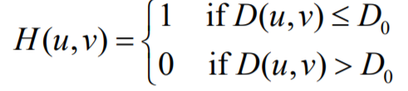
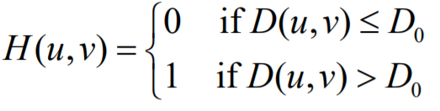

Ideal Filter
An ideal filter characteristic passes a finite block of frequencies unaltered while completely removing frequencies outside the pass band
Ideal Low Pass for smoothing Ideal High Pass for sharpening

Slide 11
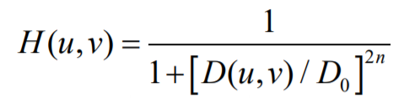
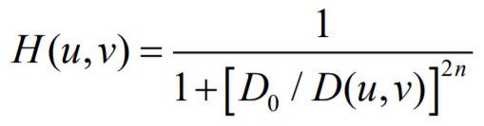
Butterworth Filter
The Butterworth filter is a type of filter designed to have as flat a frequency response as possible
Butterworth Low Pass Filter Butterworth High Pass Filter
‘n’ is the order

Slide 12


Gaussian Filter
A Gaussian filter is a linear filter. It's usually used to blur the image or to reduce noise.
Gaussian Low Pass Filter Gaussian High Pass Filter

Slide 13
Olympic Filter
Type of filter which discards the extreme top and bottom values of e.g. a grid of pixels, before making a calculation. * Named after practice at some Olympic games in which extreme scores given by judges on a panel are discounted when calculating the average.

Slide 14

Homomorphic Filter
Homomorphic filter simultaneously normalizes the brightness across an image and increases contrast

Slide 15
Suggesting a filter
Suggestion is based on PSNR value.
Peak Signal - to - Noise Ratio
It is calculated to the result images of all the implemented filters. The one with the best PSNR value is suggested to the user

Slide 16
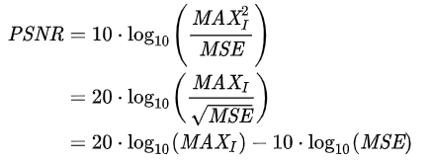

PSNR Value
PSNR is most easily defined via the mean squared error (MSE)
Given a noise-free m×n monochrome image I and its noisy approximation K, MSE is defined as:

Slide 17
Implementation & Reuse
What Inbuilt we are planning to use:
•Numpy for FFT (for frequency filtering)
•OpenCV for displaying images
Tkinter for GUI Implementation

Slide 18
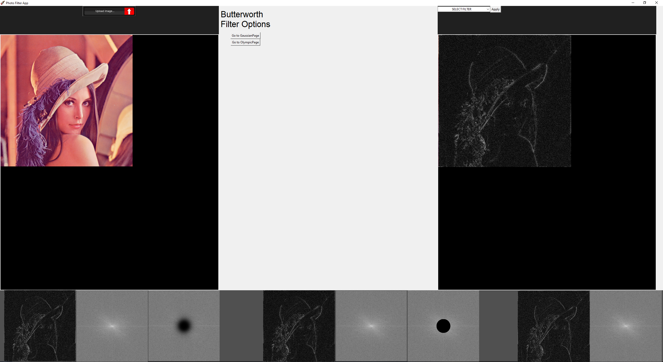

Slide 19
Issues
Tkinter/PIL/numpy conversion implementation
Homomorphic filter recursion loop
Minor Olympic filter image reshape issue

